Slide 1
Workflow Management Systems
Used for scientific workflows for data analyses
Pipelines (automated workflows)
  Sequence of tasks,
    Gathering, cleaning, and processing data.
  Can work with multiple software packages
  Taking over from the messy/traditionally set-up of joined scripts in bash
FAIR principle
  Findable, Accessible, Interoperable, Reusable

Slide 2


Workflow Management Systems
Makes your life easier
  Run time management
  Software management
  Portability & Interoperability
  Reproducibility
  Re-entrancy / Resumption
 | Nextflow | Snakemake
Language | Groovy (java) | Python
Workflows | nf-core | wrappers
Usage | more industry | more academia

Slide 3
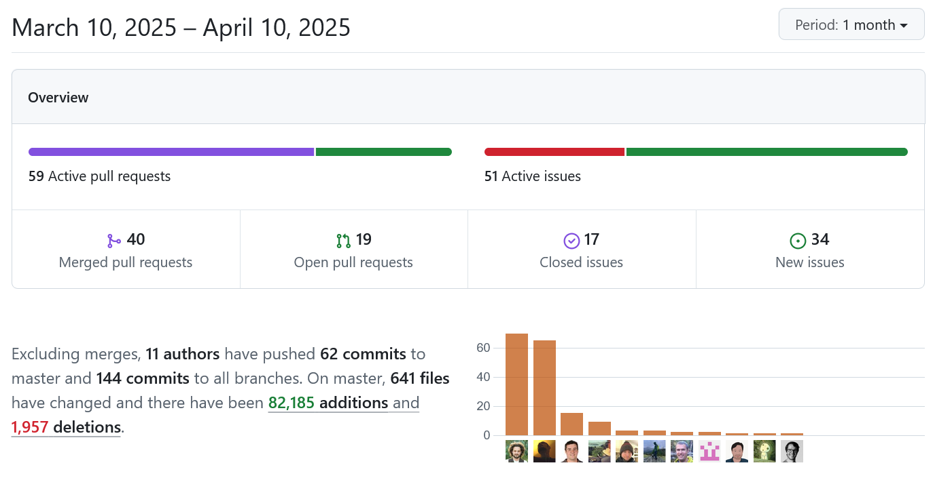
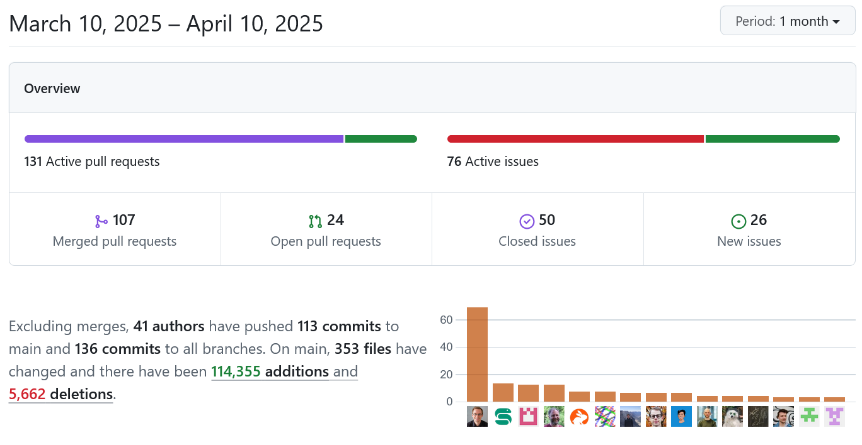
Workflow Management Systems
Active development (GitHub)
Community driven (Hackathons)

Slide 4
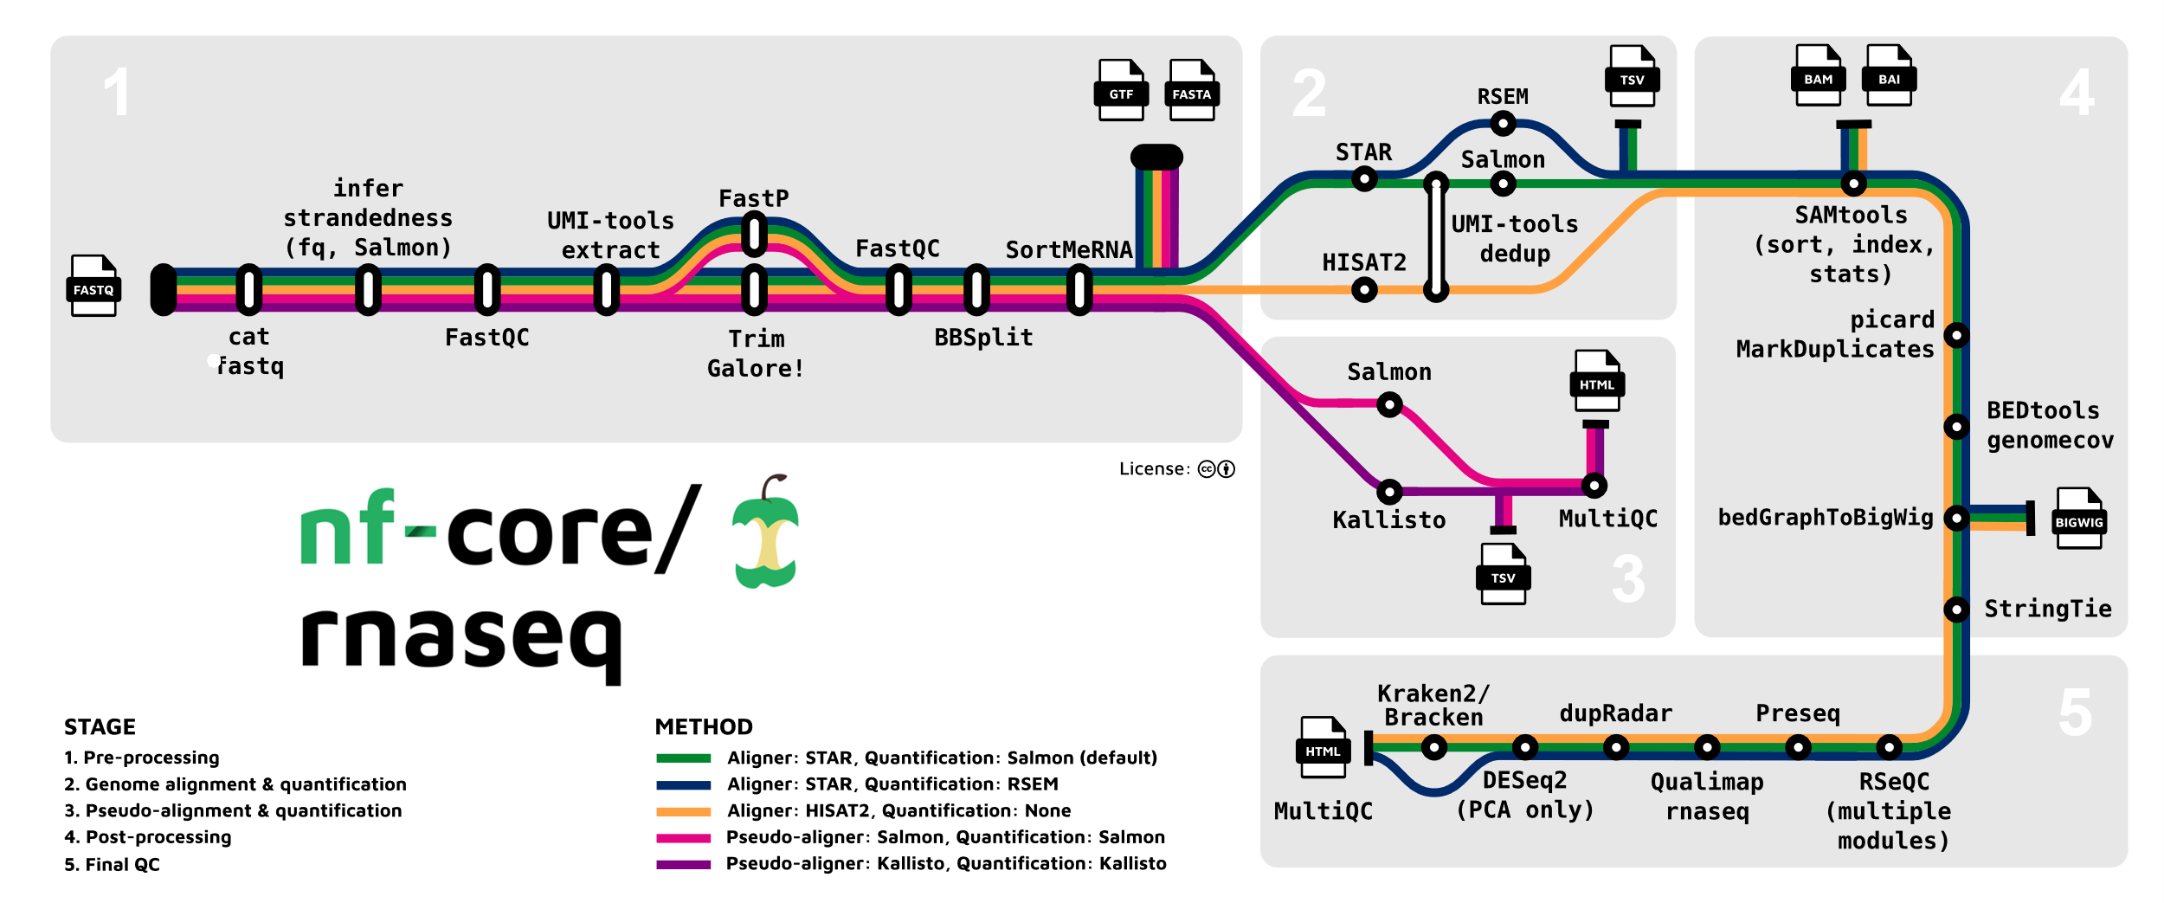
Nextflow
Write your own pipelines or use published workflows/module (https://nf-co.re)
Config file for the cluster: https://nf-co.re/configs/cropdiversityhpc/
srsh --mem=12Gb --cpus-per-task=2
mkdir Testing
nextflow run nf-core/rnaseq -profile test,cropdiversityhpc --outdir .

Slide 5
Interested in learning more:
Online training and tutorials:
  https://training.nextflow.io/latest/
  https://snakemake.readthedocs.io/en/stable/tutorial/tutorial.html
Problems:
  GitHub issues
  Slack Channel (Nextflow or Cropdiversity HPC)

